Slide 1

Crimes Against Women in India
Submitted by :-
Aakash
Anjali
Lija
Om

Slide 2

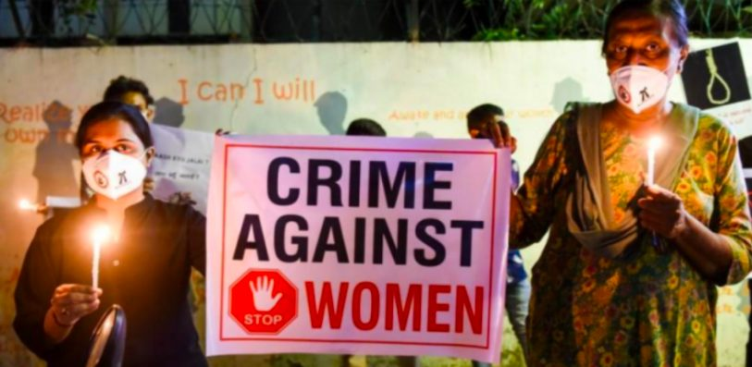
This presentation explores the concerning trends and statistics of various crimes committed against women in India from 2001 to 2021. It sheds light on the alarming prevalence of domestic violence, sexual assault, dowry-related crimes, and other forms of violence that continue to plague Indian society.

Slide 3


Domestic Violence: Trends and Statistics
1
Prevalence
2
Reporting
Domestic violence remains a pervasive issue, with a significant number of women experiencing physical, emotional, or sexual abuse within their homes.
Underreporting is a major challenge, as many victims are reluctant to come forward due to fear, shame, or lack of awareness.
3
Impact
4
Legislation
Domestic violence has devastating consequences for women's physical and mental health, their well-being, and their overall quality of life.
India has enacted laws to protect victims of domestic violence, but implementation and enforcement remain areas of concern.

Slide 4

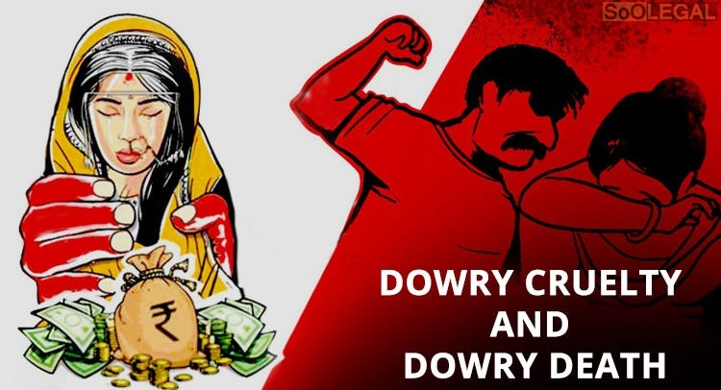
Dowry-related Crimes and Harassment
1
Dowry System
The traditional dowry system, where the bride's family is expected to provide gifts to the groom's family, has been misused and often leads to violence and harassment.
2
Forms of Abuse
Dowry-related crimes can include physical and emotional abuse, threats, and even murder. This issue is deeply rooted in societal pressures and gender inequality.
3
Legal Measures
India has enacted laws to prohibit dowry demands and punish those who engage in such practices, but enforcement remains a significant challenge.

Slide 5
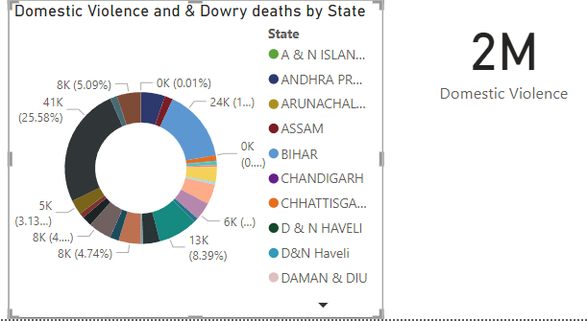
Domestic Violence & Dowry Deaths (2001-2021)

Slide 6
Sexual Assault and Rape: A Persistent Epidemic
Statistics
Causes
Consequences
The number of reported cases of sexual assault and rape has increased over the years, though the actual number is likely much higher due to underreporting.
Factors contributing to this epidemic include patriarchal attitudes, societal norms, and a lack of awareness about consent and sexual rights.
Victims face physical injuries, psychological trauma, social stigma, and often experience challenges in accessing justice.

Slide 7
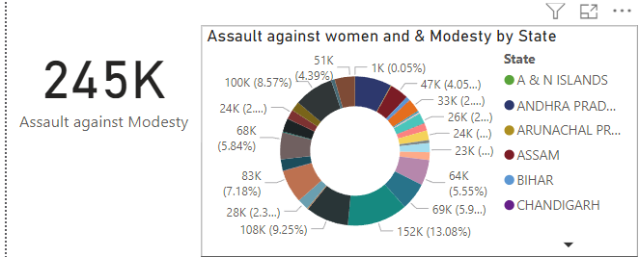
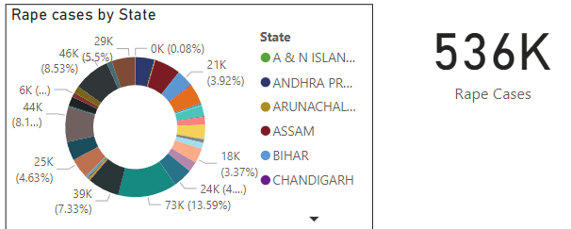
Assault and Rape

Slide 8

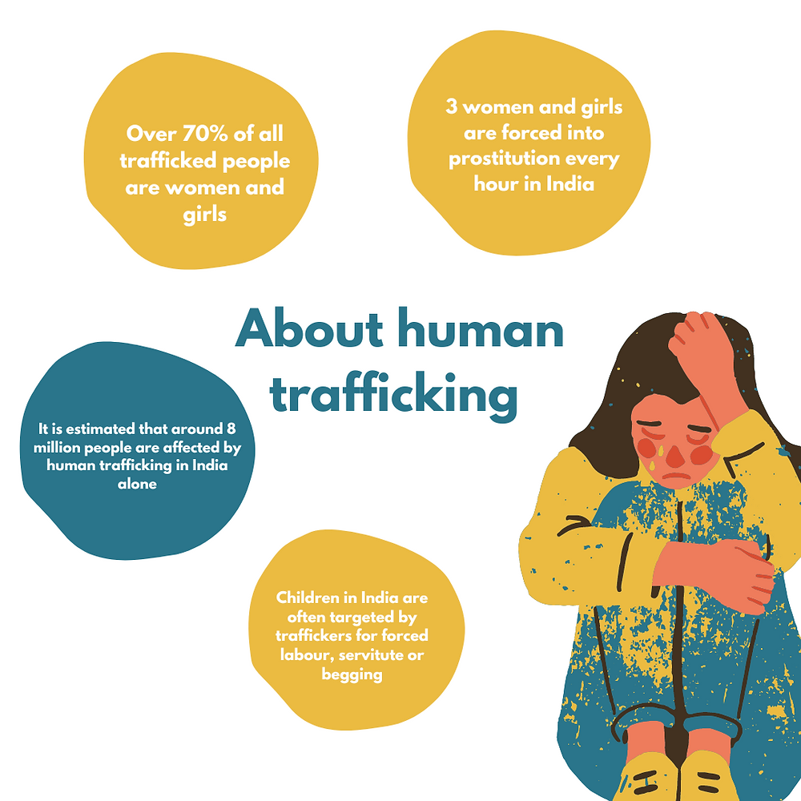



Trafficking of Women and Girls
Exploitation
Trafficking often involves forced labor, sexual exploitation, and other forms of abuse, depriving women and girls of their basic rights and freedom.
Vulnerability
Victims of trafficking are often from disadvantaged backgrounds and are vulnerable to promises of better opportunities or false employment offers.
Combating Trafficking
Combating trafficking requires a multi-faceted approach, including law enforcement, social welfare programs, and awareness campaigns.

Slide 9
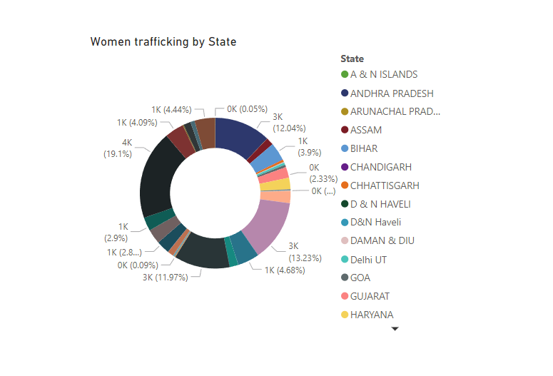
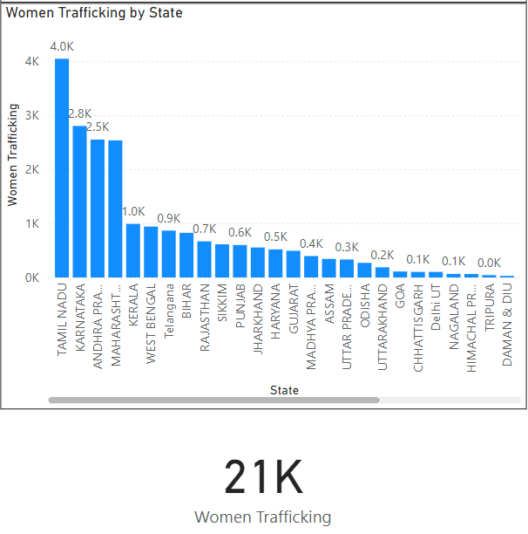
Trafficking of Women and Girls (2001-2021)

Slide 10

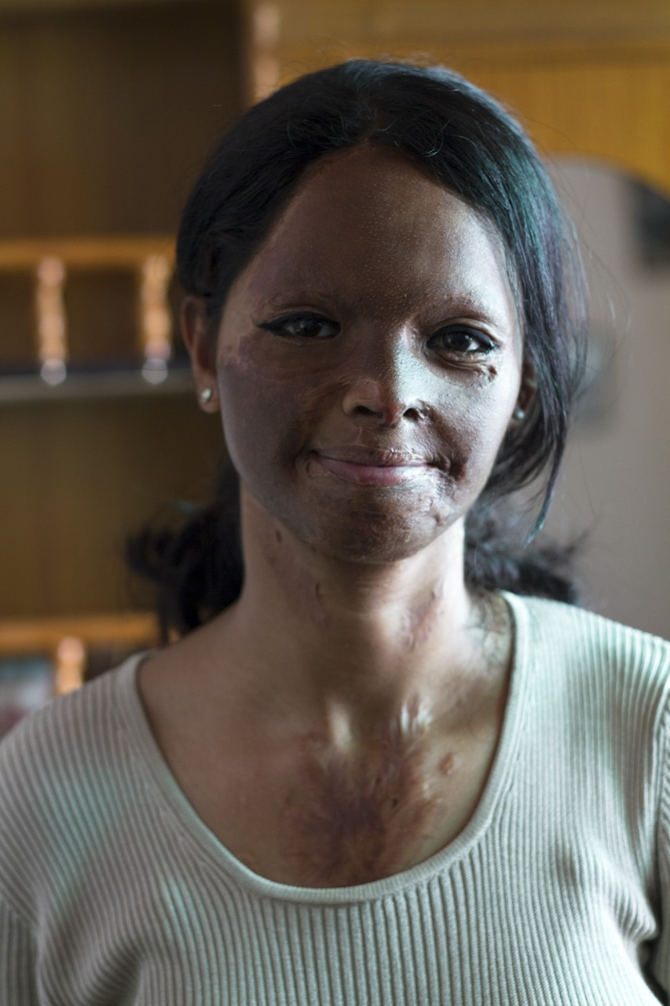
Acid Attacks: A Horrific Form of Violence
Motivation
Impact
Acid attacks are often perpetrated by individuals seeking revenge, rejection, or to punish women for rejecting their advances.
The physical and psychological scars are long-lasting, causing severe disfigurement, pain, and trauma for the victims.
Prevention
Measures to prevent acid attacks include stricter regulations on the sale of acid, stronger law enforcement, and societal awareness campaigns.

Slide 11

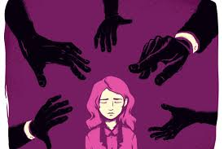
Crimes in the Workplace: Sexual Harassment
Forms of Harassment
Examples
Verbal
Unwelcome sexual comments, jokes, or propositions
Physical
Unwanted touching, grabbing, or assault
Visual
Displaying sexually suggestive materials or images
Psychological
Creating a hostile work environment through intimidation or threats

Slide 12


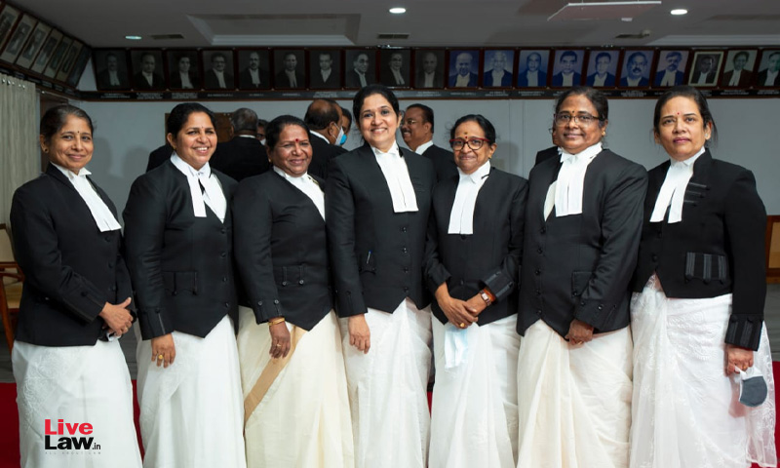


Honor Killings: A Violation of Human Rights
Motivations
Honor killings are often driven by rigid societal norms and a belief that women must conform to traditional values.
Consequences
These acts of violence result in the brutal murder of women who are perceived to have brought shame or dishonor to their families.
Efforts
Combating honor killings requires a change in attitudes and beliefs, as well as stronger law enforcement and support for victims.

Slide 13

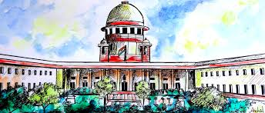
Challenges in the Criminal Justice System
Law Enforcement
Judicial System
The police force faces challenges in effectively investigating and addressing crimes against women, including corruption, lack of resources, and biases.
The judicial system also faces challenges, including delays in trials, inadequate victim support, and sometimes a lack of sensitivity to the needs of women.

Slide 14

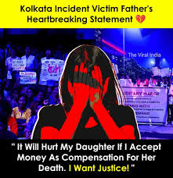
Efforts to Improve Women's Safety and Justice
1
Legislation
2
Awareness Campaigns
India has enacted various laws to protect women's rights, including laws against domestic violence, sexual assault, and trafficking.
Awareness campaigns play a crucial role in challenging societal norms, promoting gender equality, and empowering women.
3
Support Networks
4
Empowerment
Support networks, such as women's shelters and counseling services, provide vital assistance to victims of violence and abuse.
Empowering women through education, economic opportunities, and access to legal aid is essential to combat violence and promote their well-being.

Slide 15
